Slide 1
Real Time communications

Slide 2




How do you watch a movie or video from the internet
First option is to download the video
File to a local computer and watch it
This make video playback smooth, however it needs
Local disk space and copyright issues.

Slide 3
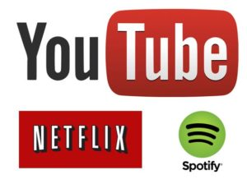



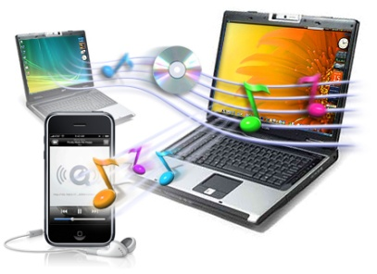


This is where Real time Streaming comes into picture
With the size of video files going towards Giga Bytes rage and complex copy right issues, downloading a local copy is not a feasible option. Especially with hand held devices

Slide 4
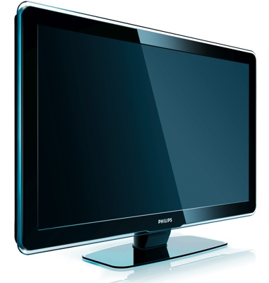

What was the though process behind RTSP

Slide 5
Provide TV or DVD like real time experience to user without local storage
Multiple Streaming servers around the world that can be accessed through Internet.
Media stream which looks very similar to TV Channels
Watch latest movies from the comfort of home at times you prefer
Pause and Play media as your prefer
Live streaming of current news (with an option to watch it later)
Give access media without violating the copyrights
Unlimited access to selected songs
Prevent unauthorized use of media and piracy (concern for Artists)

Slide 6
How RTSP evolved
RTSP was developed by Netscape RealNetworks and Columbia University, in 1996 and the first draft submitted to IETF. It was standardized by the Multiparty Multimedia Session Control Working Group (MMUSIC WG) of the Internet Engineering Task Force (IETF) and published as RFC 2326 in 1998.^{[3]} RTSP 2.0 published as RFC 7826 in 2016 as a replacement of RTSP 1.0. RTSP 2.0 is based on RTSP 1.0 but is not backwards compatible other than in the basic version negotiation mechanism.

Slide 7
Real Time Streaming Protocol
Real time streaming protocol is a combination of three protocols
RTSP (Real Time Streaming Protocol) which works over TCP
RTP (Real time protocol) which works over UDP
RTCP (Real Time Control Protocol)
RTSP is used for signaling and RTP is used for real time media

Slide 8
RTSP
RTSP is text based protocol very similar to HTTP
IT uses same URL Structure as HTTP
Eg: rtsp://mpv.cdn3.bigCDN.com:554/bigCDN/definst/mp4:bigbuckbunnyiphone_400.mp4
The key difference between RTPS and HTTP comes when it comes to state.
HTTP is a stateless protocol means, there is no need to maintain a state information
Where has RTP is a state-full protocol, it maintains the state of playback of every stream

Slide 9
How HTTP works
GET /index.html HTTP/1.1 Host: www.example.com
HTTP/1.1 200 OK
Date: Mon, 23 May 2005 22:38:34 GMT
Content-Type: text/html; charset=UTF-8 Content-Encoding: UTF-8 Content-Length: 138
Last-Modified: Wed, 08 Jan 2003 23:11:55 GMT
Server: Apache/1.3.3.7 (Unix) (Red-Hat/Linux)
ETag: "3f80f-1b6-3e1cb03b"
Accept-Ranges: bytes Connection: close
<html> <head> <title>An Example Page</title> </head> <body> Hello World, this is a very simple HTML document. </body> </html>

Slide 10
How RTSP works
The streaming client which runs on your laptop or mobile phone or tablet or Smart TV will open a TCP/IP and establish a connection to port 554 on the server and issue a RTSP OPTIONS command showing the protocol version used for the session. This is to tell the server which version of the protocol was used while implementing/developing the streaming application
The server acknowledges this with a 200 OK message, provided the server can talk to client with the current protocol it support. This is very similar to HTTP
OPTIONS rtsp://video.foocorp.com:554 RTSP/1.0 Cseq: 1
RTSP/1.0 200 OK Cseq: 1

Slide 11
DESCRIBE rtsp://video.foocorp.com:554/streams/example.rm RTSP/1.0 Cseq:2
RTSP/1.0 200 OK Cseq: 2 Content-Type: application/sdp Content-Length: 210
<SDP Data...>
SETUP rtsp://video.foocorp.com:554/streams/example.rm RTSP/1.0
Cseq: 3 Transport: rtp/udp;unicast;client_port=5067-5068
RTSP/1.0 200 OK
Cseq: 3
Session: 12345678
Transport: rtp/udp;client_port=5067-5068;server_port=6023-6024

Slide 12
PLAY rtsp://video.foocorp.com:554/streams/example.rm RTSP/1.0
Cseq: 4 Session: 12345678
RTSP/1.0 200 OK Cseq: 4
Media Data through RTP
TEARDOWN rtsp://video.foocorp.com:554/streams/example.rm RTSP/1.0 Cseq: 5 Session: 12345678
RTSP/1.0 200 OK Cseq: 5

Slide 13
Comparison of HTTP and RTSP
No | RTSP | HTTP
1 | OPTIONS | OPTIONS
2 | DESCRIBE | HEAD
3 | SETUP | CONNECT
4 | PLAY | GET
5 | PAUSE | DELETE
6 | RECORD | POST
7 | ANNOUNCE | PUT
8 | TEARDOWN | DELETE
9 | GET_PARAMETER | TRACE
10 | SET_PARAMETER | PATCH

Slide 14
Why do you need real time communication browsers and mobile apps
Future of Real Time communication is going to be based on WEB based applications that can run from browsers
Just like the way Internet and Web Browsing changed the way we access information, Real time communication is also going to change drastically with mobile apps and Web Browsers. In future all communications will have launched from a common “Cockpit” – which is the Web Browser.

Slide 15
How do browsers perform real time communication
For a Web Browser to do real time communication it needs to be enabled with a set of libraries and API for real time communication, so that users can use those feature as if they are clicking a link on the web page.
This is exactly what WEBRTC does
https://webrtc.org/

Slide 16
What is WebRTC
WebRTC is an open standard for web-based real time communication using a browser. It is a technology that enables easy transmission of media (voice, video, etc.) over the internet using a web browser.
WebRTC changes the present model model by directly embedding the ability to send media (such as audio or video) into a web browser. No phone required, no download or software install required. The browser makes use of a microphone, speakers, and/or camera attached to the computer to send audio and/or video. This means that a user can communicate with others with basically nothing but a browser and internet connection.
https://apprtc.appspot.com/

Slide 17
Use Cases of WEBRTC
Real-time marketing
Real-time advertising
Back office communications
HR management
Social networking
Online medical consultations
Financial services
Surveillance
Multiplayer games
Live broadcasting
E-learning

Slide 18
How does it works
WebRTC allows you to set up peer-to-peer connections to other web browsers quickly and easily. To build such an application from scratch, you would need a wealth of frameworks and libraries dealing with typical issues like data loss, connection dropping, and NAT traversal. With WebRTC, all of this comes built-in into the browser out-of-the-box. This technology doesn't need any plugins or third-party software. It is open-sourced and its source code is freely
It make use a concept called WebSockets

Slide 19
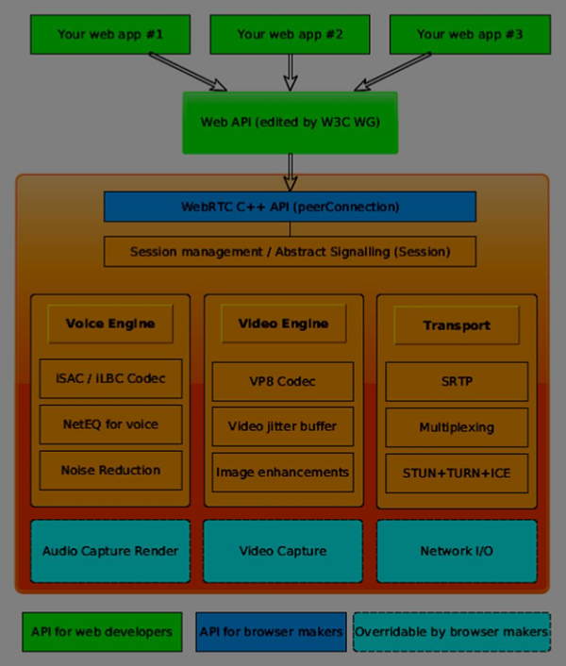

Slide 20
VOIP and Cloud
VOIP is made to available over cloud WEBRTC is the main enabler for it
Another Version of RTP called SRTP – Secured RTP is made used for it
The Secure Real-time Transport Protocol (or SRTP) defines a profile of RTP (Real-time Transport Protocol), intended to provide encryption, message authentication and integrity, and replay protection to the RTP data in both unicast and multicast applications

